Slide 1
Tableau

Slide 2
Tableau Desktop
If you are an individual user, Tableau Desktop is the tool for you. It's an application that resides on your computer and is aimed at individual use. It is used for creating data visualizations, publishing data sources as well as workbooks to Tableau Server.

Slide 3
Common visualization Tools
Plotly: Plotly can produce some very slick graphics. ...
DataHero: Anyone can use this to make sense of data from multiple services. ...
Chart.js. ...
Tableau. ...
Raw. ...
Dygraphs. ...
ZingChart. ...
InstantAtlas.

Slide 4
File Type in Tableau

Slide 5
File Type | File Extension | Purpose
Tableau Workbook | .twb | It contains information on each sheet and dashboard that is present in a workbook. It has the details of the fields, which are used in each view and the formula applied to the aggregation of the measures. It also has the formatting and styles applied. It contains the data source connection information and any metadata information created for that connection.
Tableau Packaged Workbook | .twbx | This file format contains the details of a workbook as well as the local data that is used in the analysis. Its purpose is to share with other Tableau desktop or Tableau reader users, assuming it does not need data from the server.
Tableau Data Source | .tds | The details of the connection used to create the tableau report are stored in this file. In the connection details, it stores the source type (excel/relational/sap, etc.) as well as the data types of the columns.
Tableau Packaged Data source | .tdsx | This file is similar to the .tds file with the addition of data along with the connection details.
Tableau Data Extract | .tde | This file contains the data used in a .twb file in a highly compressed columnar data format. This helps in storage optimization. It also saves the aggregated calculations that are applied in the analysis. This file should be refreshed to get the updated data from the source.
Tableau Bookmark | .tbm | These files contain a single worksheet that is shared easily to be pasted into other workbooks.
Tableau Preferences | .tps | This file stores the color preference used across all the workbooks. It is mainly used for consistent look and feel across the users.

Slide 6
Joining data sources
In Tableau Desktop: On the Start page, under Connect, click a connector to connect to your data. ...
Select the file, database, or schema, and then double-click or drag a table to the canvas.

Slide 7
Join Type | Result | Description
Inner | When you use an inner join to combine tables, the result is a table that contains values that have matches in both tables.
Left | When you use a left join to combine tables, the result is a table that contains all values from the left table and corresponding matches from the right table. When a value in the left table doesn't have a corresponding match in the right table, you see a null value in the data grid.
Right | When you use a right join to combine tables, the result is a table that contains all values from the right table and corresponding matches from the left table. When a value in the right table doesn't have a corresponding match in the left table, you see a null value in the data grid.
Full outer | When you use a full outer join to combine tables, the result is a table that contains all values from both tables. When a value from either table doesn't have a match with the other table, you see a null value in the data grid.
Union | Though union is not a type of join, union is another method for combining two or more tables by appending rows of data from one table to another. Ideally, the tables that you union have the same number of fields, and those fields have matching names and data types. For more information about union, see Union Your Data.

Slide 8
Connect
Tableau can connect to all the popular data sources which are widely used. Tableau’s native connectors can connect to the following types of data sources.
File Systems such as CSV, Excel, etc.
Relational Systems such as Oracle, Sql Server, DB2, etc.
Cloud Systems such as Windows Azure, Google BigQuery, etc.
Other Sources using ODBC
The following picture shows most of the data sources available through Tableau’s native data connectors.

Slide 9
Connect Cont..
Connect Live
The Connect Live feature is used for real-time data analysis. In this case, Tableau connects to real-time data source and keeps reading the data. Thus, the result of the analysis is up to the second, and the latest changes are reflected in the result. However, on the downside, it burdens the source system as it has to keep sending the data to Tableau.
In-Memory
Tableau can also process data in-memory by caching them in memory and not being connected to the source anymore while analyzing the data. Of course, there will be a limit to the amount of data cached depending on the availability of memory.
Combine Data Sources
Tableau can connect to different data sources at the same time. For example, in a single workbook you can connect to a flat file and a relational source by defining multiple connections. This is used in data blending, which is a very unique feature in Tableau.

Slide 10
Data Blending
It is used when there is related data in multiple data sources, which you want to analyze together in a single view. As an example, consider the Sales data is present in a relational database and Sales Target data in an Excel spreadsheet.

Slide 11
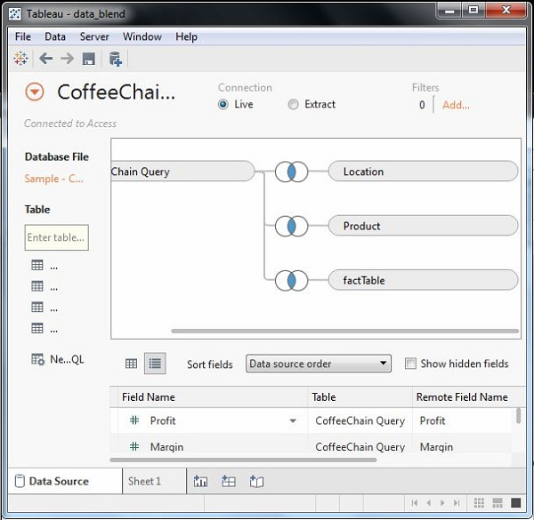

Slide 12
Extracting data
Data extraction in Tableau creates a subset of data from the data source. This is useful in increasing the performance by applying filters. It also helps in applying some features of Tableau to data which may not be available in the data source like finding the distinct values in the data. However, the data extract feature is most frequently used for creating an extract to be stored in the local drive for offline access by Tableau.
Creating an Extract
Extraction of data is done by following the
menu - Data → Extract Data.
It creates many options such as applying limits to how many rows to be extracted and whether to aggregate data for dimensions. The following screen shows the Extract Data option.
Applying Extract Filters
To extract a subset of data from the data source, you can create filters which will return only the relevant rows.

Slide 13
Extracting Data Cont...
Adding New Data to Extract
To add more data for an already created extract, you can choose the option
Data → Extract → Append Data from File.
In this case, browse the file containing the data and click OK to finish. Of course, the number and datatype of columns in the file should be in sync with the existing data.
Extract History
You can verify the history of data extracts to be sure about how many times the extract has happened and at what times.
For this, you can use the menu - Data → Extract History.

Slide 14
Data extracts vs. live connections
Tableau Data Extracts are snapshots of data optimized for aggregation and loaded into system memory to be quickly recalled for visualization.
Extracts are saved subsets of data that you can use to improve performance or to take advantage of Tableau functionality not available or supported in your original data. When you create an extract of your data, you can reduce the total amount of data by using filters and configuring other limits.
Tableau is a query based tool; not a live streaming tool. A Live Connection means that Tableau sends queries to your database, and retrieves data. Generally, these queries will return whatever data is currently in the database; with one important exception – any data currently in Tableau's cache.

Slide 15
S.No | Terms & Meaning
1 | Alias An alternative name that you can assign to a field or to a dimension member.
2 | Bin A user-defined grouping of measures in the data source.
3 | Bookmark A .tbm file in the Bookmarks folder in the Tableau repository that contains a single worksheet. Much like web browser bookmarks, .tbm files are a convenient way to quickly display different analyses.
4 | Calculated Field A new field that you create by using a formula to modify the existing fields in your data source.
5 | Crosstab A text table view. Use text tables to display the numbers associated with dimension members.
6 | Dashboard A combination of several views arranged on a single page. Use dashboards to compare and monitor a variety of data simultaneously.

Slide 16
7 | Data Pane A pane on the left side of the workbook that displays the fields of the data sources to which Tableau is connected. The fields are divided into dimensions and measures. The data pane also displays custom fields such as calculations, binned fields, and groups. You build views of your data by dragging fields from the data pane onto the various shelves that are a part of every worksheet.
8 | Data Source Page A page where you can set up your data source. The data source page generally consists of four main areas − left pane, join area, preview area, and metadata area.
9 | Dimension A field of categorical data. Dimensions typically hold discrete data such as hierarchies and members that cannot be aggregated. Examples of dimensions include dates, customer names, and customer segments.
10 | Extract A saved subset of a data source that you can use to improve performance and analyze offline. You can create an extract by defining filters and limits that include the data you want in the extract.

Slide 17
11 | Filters Shelf A shelf on the left of the workbook that you can use to exclude data from a view by filtering it using measures and dimensions.
12 | Format Pane A pane that contains formatting settings that control the entire worksheet, as well as individual fields in the view. When open, the Format pane appears on the left side of the workbook.
13 | Level Of Detail (LOD) Expression A syntax that supports aggregation at dimensionalities other than the view level. With the level of detail expressions, you can attach one or more dimensions to any aggregate expression.
14 | Marks A part of the view that visually represents one or more rows in a data source. A mark can be, for example, a bar, line, or square. You can control the type, color, and size of marks.
15 | Marks Card A card to the left of the view, where you can drag fields to control mark properties such as type, color, size, shape, label, tooltip, and detail.

Slide 18
16 | Pages Shelf A shelf to the left of the view that you can use to split a view into a sequence of pages based on the members and values in a discrete or continuous field. Adding a field to the Pages shelf is like adding a field to the Rows shelf, except that a new page is created for each new row.
17 | Rows Shelf A shelf at the top of the workbook that you can use to create the rows of a data table. The shelf accepts any number of dimensions and measures. When you place a dimension on the Rows shelf, Tableau creates headers for the members of that dimension. When you place a measure on the Rows shelf, Tableau creates quantitative axes for that measure.
18 | Shelves Named areas to the left and top of the view. You build views by placing fields onto the shelves. Some shelves are available only when you select certain mark types. For example, the Shape shelf is available only when you select the Shape mark type.
19 | Workbook A file with a .twb extension that contains one or more worksheets (and possibly also dashboards and stories).
20 | Worksheet A sheet where you build views of your data by dragging fields onto shelves.

